Slide 1
SER 334 A Session
SI Session
Monday February 12th 2024
7:00 pm - 8:00 pm MST

Slide 2
{
Agenda
Scheduling Algorithms
Terms
Algorithms
Sample Problems

Slide 3
SI Session Expectations
Thanks for coming to the SER 334 SI session. We have a packed agenda and we are going to try to get through as many of our planned example problems as possible. This session will be recorded and shared with others.
If after this you want to see additional examples, please visit the drop-in tutoring center.
We will post the link in the chat now and at the end of the session.
tutoring.asu.edu
Please keep in mind we are recording this session and it will be made available for you to review 24-48 hours after this session concludes.
Finally, please be respectful to each other during the session.

Slide 4

Interact with us:
Zoom Features
Zoom Chat
Use the chat feature to interact with the presenter and respond to presenter’s questions.
Annotations are encouraged

Slide 5
Think state change!
SER 334
Scheduling
What are the four scheduling event triggers?
Running → Waiting
Running → Ready
Waiting → Ready
Running → Terminate

Slide 6
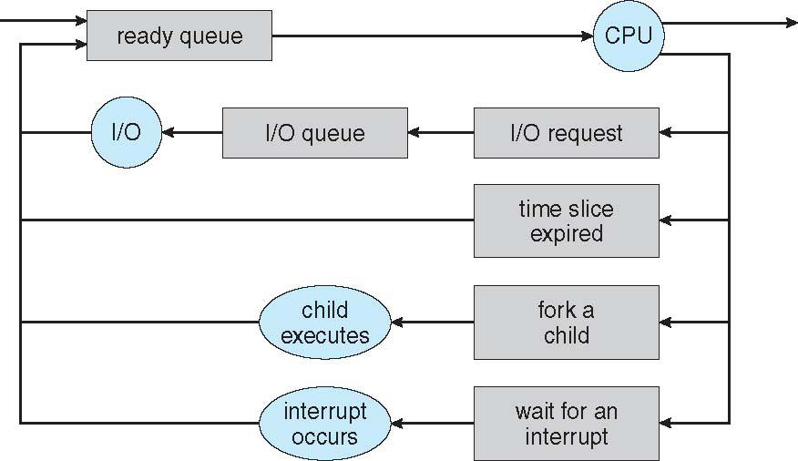
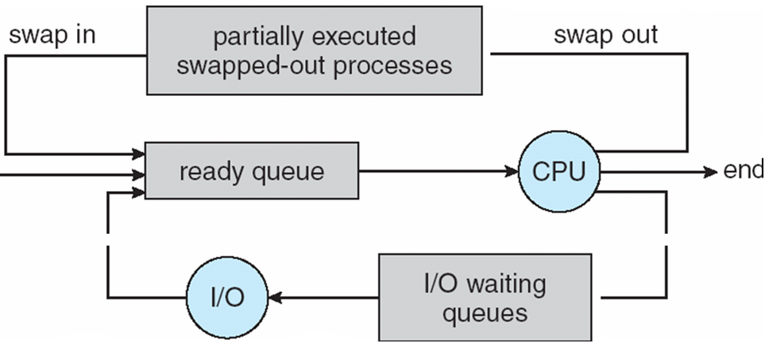
Running → Waiting
Running → Ready
SER 334
Waiting → Ready
Running → Terminate
Scheduling

Slide 7
Reviewing Terms
SER 334
Scheduling
A scheduler can be preemptive or non-preemptive, which is which?
Can only “grab” the process after completion
Can “grab” the process at any time

Slide 8
SER 334
Scheduling
Which two scheduling event triggers are preemptive?
Running → Waiting
Running → Ready
Waiting → Ready
Running → Terminate

Slide 9
SER 334
Scheduling
Which two scheduling event triggers are preemptive?
Preemptive
Running → Waiting
Running → Ready
Preemptive
Waiting → Ready
Running → Terminate

Slide 10
Reviewing Terms
SER 334
Scheduling
Match the algorithm types to their definitions:
Live Algorithm
Streaming Algorithm
Greedy Algorithm
Chooses the immediate best option
Meant to run forever, continuously updating
Runs over partitions of the larger data set

Slide 11
Reviewing Terms
SER 334
Scheduling
Match the algorithm types to their definitions:
Live Algorithm
Streaming Algorithm
Greedy Algorithm
Chooses the immediate best option
Meant to run forever, continuously updating
Runs over partitions of the larger data set

Slide 12
Reviewing Terms
SER 334
Scheduling
CPU Utilization
Throughput
Turnaround Time
Waiting Time
Response Time
Tasks completed in X amount of time
Time until a response/result is received
Time spent in the Ready Queue
Usage in terms of maximum load
Completion time for one task

Slide 13
Reviewing Terms
SER 334
Scheduling
CPU Utilization
Throughput
Turnaround Time
Waiting Time
Response Time
Tasks completed in X amount of time
Time until a response/result is received
Time spent in the Ready Queue
Usage in terms of maximum load
Completion time for one task

Slide 14
Module 9 Sample
SER 334
First-Come First-Served
Scheduling Algorithms
P0, 12
P1, 6
P2, 3
P3, 4
Avg Completion Time: END time / # processes
(TURNAROUND)
Avg Waiting Time: START time / # processes
Notes:
Completion: 19
Waiting: 12.75

Slide 15
Module 9 Sample
SER 334
Shortest Job First
Scheduling Algorithms
Focus: Burst Time
P0, 12
P1, 6
P2, 3
P3, 4
Avg Completion Time: END time / # processes
(TURNAROUND)
Avg Waiting Time: START time / # processes
Notes:
Completion: 12
Waiting: 5.75

Slide 16
SER 334
Shortest Job First LIVE
Scheduling Algorithms
T_{n+1}= a(t_{n}) + (1 - a)T_{n}
t_{n} = actual burst, T_{n} = CPU guess, a = weight (usually 0.5)
P0, 12
P1, 6
P2, 3
P3, 4
T₁= (0.5)(12) + (0.5)15
T₂= (0.5)(6) + (0.5)13.5
T₃= (0.5)(3) + (0.5)9.75
T₄= (0.5)(6) + (0.5)6.375
T₁= 13.5
T₂= 9.75
T₃= 6.375
T₄= 5.1875
Avg Completion Time: END time / # processes
(TURNAROUND)
Avg Waiting Time: START time / # processes

Slide 17
Module 9 Sample
SER 334
Round Robin
Scheduling Algorithms
Quantum = 5
P0, 10
P1, 6
P2, 7
P3, 4
5
10
15
20
25
30
Avg Completion Time: (WAIT+BURST) / # processes
(TURNAROUND)
Avg Waiting Time: (slices that are not me) / #processes

Slide 18
Module 9 Sample
SER 334
Round Robin
Scheduling Algorithms
Quantum = 5
P0, 10
P1, 6
P2, 7
P3, 4
✓
✓
✓
✓
✓
✓
✓
P0, 5
P0, 5
P1, 5
P11
P2, 5
P2, 2
P3, 4
5
10
15
20
25
30
P0
P1
P2
P3
P0
P1
P2
Avg Completion Time: (WAIT+BURST) / # processes
(TURNAROUND)
Avg Waiting Time: (slices that are not me) / #processes

Slide 19
Module 9 Sample
SER 334
Round Robin
Scheduling Algorithms
Wait Times:
14
19
20
15
P0, 10
P1, 6
P2, 7
P3, 4
✓
✓
✓
✓
✓
✓
✓
P0, 5
P0, 5
P1, 5
P11
P2, 5
P2, 2
P3, 4
Avg Wait:
68/4=17
5
10
15
20
25
30
P0
P1
P2
P3
P0
P1
P2
Avg Completion Time: (WAIT+BURST) / # processes
(TURNAROUND)
Avg Waiting Time: (slices that are not me) / #processes

Slide 20
Module 9 Sample
SER 334
Round Robin
Scheduling Algorithms
Turnaround:
14
+ 10 = 24
19
+ 6 = 25
20
+ 7 = 27
15
+ 4 = 19
P0, 10
P1, 6
P2, 7
P3, 4
✓
✓
✓
✓
✓
✓
✓
P0, 5
P0, 5
P1, 5
P11
P2, 5
P2, 2
P3, 4
Avg Turnaround:
95/4=23.75
5
10
15
20
25
30
P0
P1
P2
P3
P0
P1
P2
Avg Completion Time: (WAIT+BURST) / # processes
(TURNAROUND)
Avg Waiting Time: (slices that are not me) / #processes

Slide 21
Module 9 Sample
SER 334
Rate Monotonic
Scheduling Algorithms
process, period, burst
P0, 30, 15
Who goes first??
P1, 25, 15
1/30 = 0.033
1/25 = 0.04
P2 starts new period
P1 starts new period
10
20
30
40
50
60
Priority = 1/period

Slide 22
Module 9 Sample
SER 334
Rate Monotonic
Scheduling Algorithms
process, period, burst
P0, 30, 15
P1, 25, 15
1/30 = 0.033
1/25 = 0.04
P2 starts new period
P1 starts new period
10
20
30
40
50
60
P1
P 0
P1
P0
P1
Priority = 1/period
P1 usurps P0
Results in P0 missing deadline!

Slide 23
Module 9 Sample
SER 334
Rate Monotonic
Scheduling Algorithms
process, period, burst
Max CPU Load:
N(2^{1/N}-1)
2(2^{1/2}-1)=0.83
P0, 30, 15
P1, 25, 15
1/30 = 0.033
1/25 = 0.04
P2 starts new period
CPU Utilization: Burst/Period
15/30 = 0.5
P1 starts new period
CPU Utilization: Burst/Period
15/25 = 0.6
10
20
30
40
50
60
P1
P 0
P1
P0
P1
Priority = 1/period
P1 usurps P0
Results in P0 missing deadline!

Slide 24
Module 9 Sample
SER 334
Scheduling Algorithms
2. [Alvaran] You run a console-based calculator program, which waits for user input. You submit an additional problem that the program calculates and outputs to the screen. Lastly you terminate the program. Explain which parts of the scenario correspond to scheduling events? For each event, what type of scheduling is used (preemptive vs non-preemptive)? [2 points]

Slide 25
Module 9 Sample
SER 334
Scheduling Algorithms
3. [Lisonbee] Consider a scenario where all queued jobs run for a random amount of time, but all are equally important in terms of the work they complete. Of the five criteria for scheduling jobs, which one would be the most important to optimize in this situation? Explain. [2 points]
Five Criteria:
CPU Utilization
Throughput
Turnaround Time
Waiting Time
Response Time

Slide 26
Module 9 Sample
SER 334
Scheduling Algorithms
4. [Lisonbee] If you are trying to optimize for waiting time, roughly how will the processes be ordered in terms of the time they take to complete? Explain. [2 points]

Slide 27
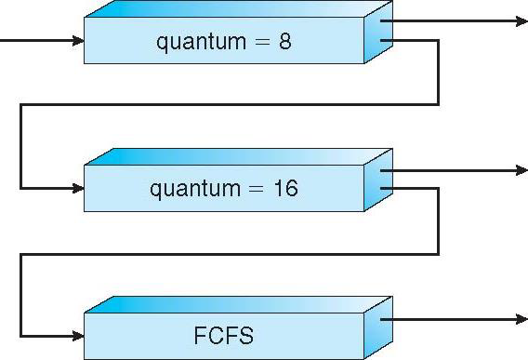
Module 9 Sample
SER 334
Scheduling Algorithms
8. [Silberschatz 6.4] What advantage is there in having different time-quantum sizes at different levels of a multilevel feedback queuing system? Explain. [2 points]

Slide 28
SER 334
Scratch Space

Slide 29
Upcoming Events
SI Sessions:
Thursday, February 15th at 7:00 pm MST
Sunday, February 18th at 7:00 pm MST
Monday, February 19th at 7:00 pm MST
Sunday, February 25th at 7:00 pm MST - Q&A Session before Exam 3
Review Sessions:
Exam 3 Review: Thursday, February 22nd at 7:00 pm MST

Slide 30

Questions?
Survey:
http://bit.ly/ASN2324

Slide 31


More Questions?
Check out our other resources!
tutoring.asu.edu
1-
2-
Click on ‘Go to Zoom’ to log onto our Online Tutoring Center.
Click on ‘View the tutoring schedule’ to see when tutors are available for specific courses.

Slide 32
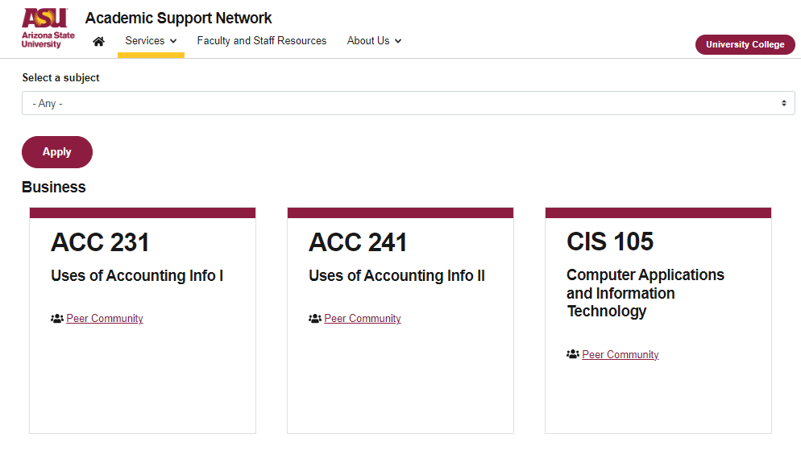

More Questions?
Check out our other resources!
tutoring.asu.edu/online-study-hub
Don’t forget to check out the Online Study Hub for additional resources!

Slide 33


Expanded Writing Support Available
Including Grammarly for Education, at no cost!
tutoring.asu.edu/expanded-writing-support
*Available slots for this pilot are limited

Slide 34
Additional Resources
Course Repo
Course Discord
BMP File Format (Wiki)
Linux Kernel API
Bootlin - Linux Cross Referencer
Dining Philosophers Interactive
Producer/Consumer Visual

